Slide 1
CitySense360: AI-Powered Smart City Intelligence
Integrated Urban Command Center for Predictive Analytics & Public Infrastructure Automation
Hida Fathima P H

Slide 2
The Urban Challenge (Problem Statement)
Data Silos: Traffic, Energy, and Safety data exist in disconnected systems, preventing holistic decision-making.
Reactive Management: Authorities rely on manual complaints and physical inspections, leading to slow response times.
The Gap: Lack of a unified, real-time platform that combines Visual Intelligence (CCTV) with Predictive Forecasting (Traffic/Energy).

Slide 3
The Solution – CitySense360
A unified "Command Center" Dashboard integrating Computer Vision, NLP, and Deep Learning.
Key Capabilities:
👁️ See: Detects accidents and road defects (YOLOv8).
📈 Predict: Forecasts Traffic, Metro ridership, and Energy loads 24h ahead (LSTM/GRU).
🗣️ Resolve: Automates citizen grievance redressal using Agentic AI (Llama 3 + DistilBERT).

Slide 4
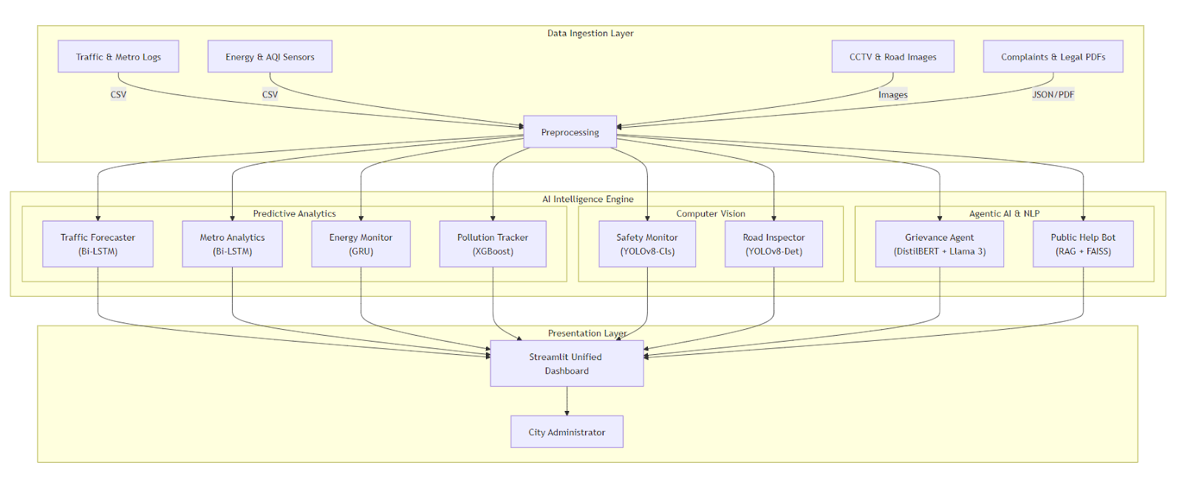
System Architecture & Deployment
Hybrid Deployment Strategy:
  Pro Version (Local/Docker): Full GPU acceleration for RAG Agents & Deep Learning.
  Lite Version (Cloud): Optimized cloud-lite branch deployed on Streamlit Community Cloud for public access .
Tech Stack:
  Core: Python 3.10, PyTorch, Streamlit.
  AI Engine: LangChain (Agents), Ultralytics (Vision), XGBoost (Pollution).
  Data: Ingests CSV logs, CCTV frames, and JSON feeds into a centralized pipeline.

Slide 5
Predictive Analytics Modules
🚦 Traffic Forecaster:
  Model: Bi-Directional LSTM.
  Result: 92.52% Accuracy in predicting congestion trends.
🚇 Metro Analytics:
  Model: Bi-LSTM for ridership demand.
  Result: 92.91% Accuracy for optimizing train frequency.
⚡ Energy Monitor:
  Model: GRU (Gated Recurrent Unit).
  Result: 95.65% Accuracy in grid load forecasting.
🌫️ Pollution Tracker:
  Model: XGBoost + Geography Encoding.
  Result: 74.77% Accuracy for hyperlocal AQI.

Slide 6
Visual & Agentic Intelligence
🚨 Safety Monitor:
  Tech: YOLOv8-Cls.
  Impact: Detects Fire/Accidents with 94.9% Confidence.
🛣️ Road Inspector:
  Tech: YOLOv8 Detection.
  Impact: Identifies Potholes/Cracks (mAP@50: 81.33%).
🤖 Public Help Bot (RAG):
  Tech: LangChain + FAISS + Llama 3.
  Impact: Answers queries using official Motor Vehicles Act & Disaster Guidelines.

Slide 7
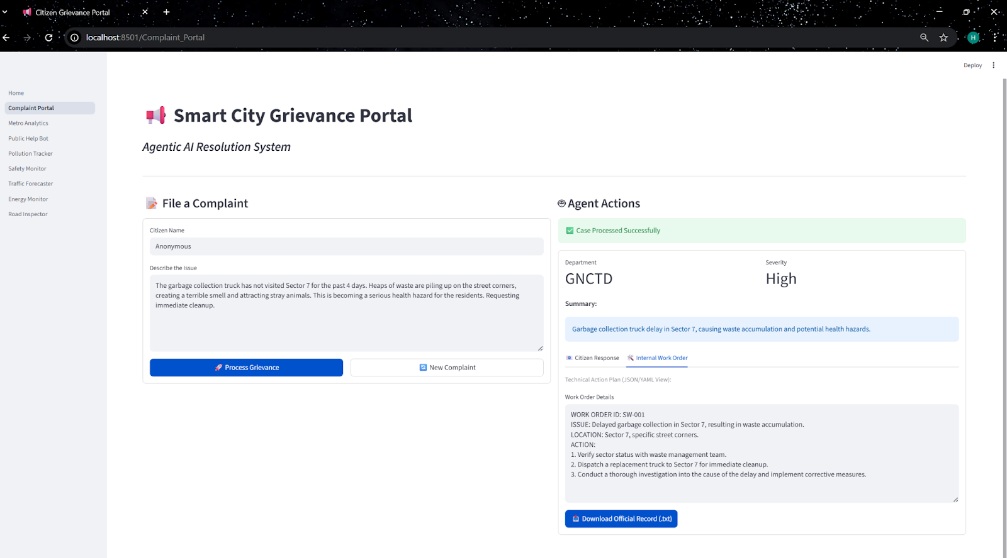
Automated Grievance Redressal (Live Demo Highlight)
The Workflow:
Ingest: Citizen files a complaint in natural language.
Classify: DistilBERT routes it to one of 81 departments (Accuracy: 84.3%).
Reason: Llama 3 Agent analyzes severity and extracts location.
Act: Generates an official "Internal Work Order" and a polite "Citizen Response" automatically.
Note: This drastically reduces manual triage time for city clerks.

Slide 8
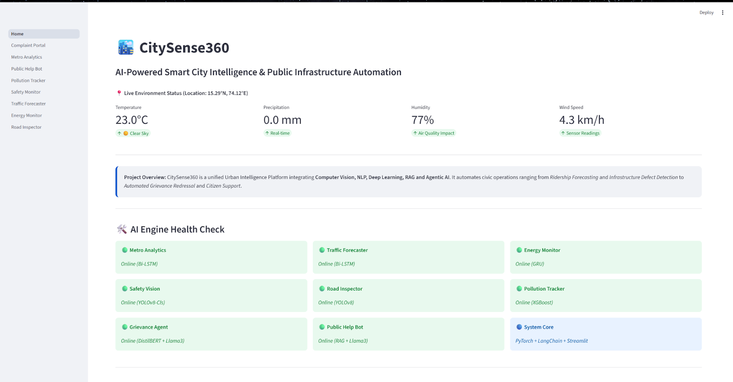
LIVE DEMO

Slide 9
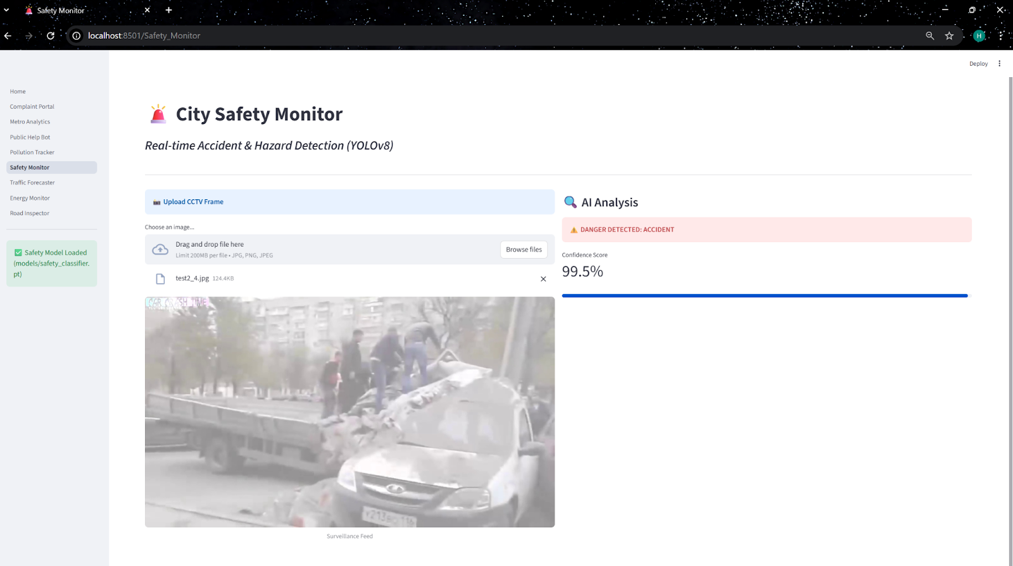

Slide 10
Conclusion & Future Scope
Achievement: Successfully deployed a multi-modal AI platform with 8 operational modules.
Key Innovation: Solved the "Resource Constraint" problem using a dual-branch Git strategy (Lite vs. Pro).
Future Scope:
  Integration with live IoT Traffic Sensors.
  Expansion to Edge Devices (Raspberry Pi/Jetson Nano) for on-street inference.

Slide 11
Thank You!!!

